Slide 1
New Workbook
File created on: 12/9/2023 1:38:51 PM

Slide 2
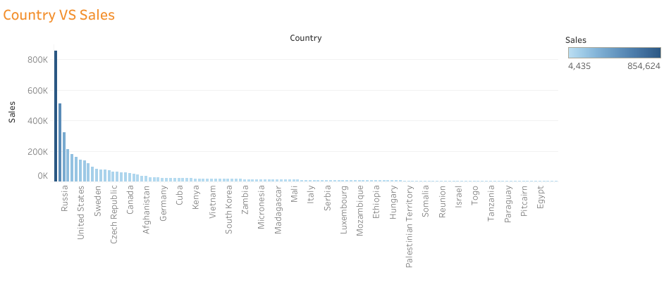

Slide 3
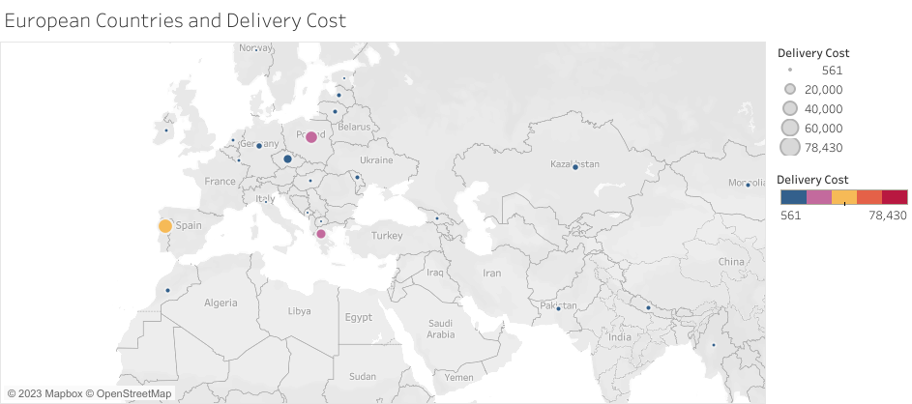

Slide 4


Slide 5
